Slide 1
LOKMANYA TILAK COLLEGE OF ENGINEERING Department of Electronics and Telecommunication Smart Solar Garden Cutter
Project stage – 1
Omkar Padwal Sushmita Bane
Pooja Kale Saurbh Singh
Guide Name -- Prof. Pranita Potey

Slide 2
Contents
Introduction
Problem Definition
Literature Survey
Methodology
Design Steps or Proposed System
Advantages
Reference

Slide 3
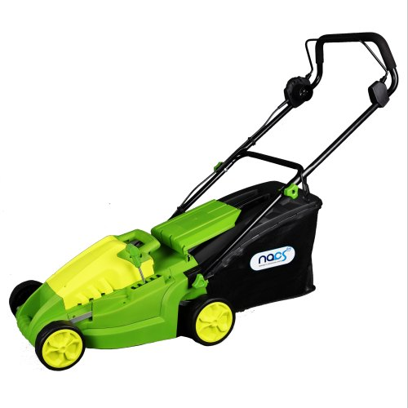
Introduction
A) Conventional grass cutters
Effect on environment and human beings
Smart Solar Grass Cutter
B) Grass cutter machines
Automatic grass cutting machine
Reduces both environment and noise pollution
Fig 1.1 Conventional cutter
[source - Google.com ]

Slide 4
Problem Definition
Factors | Conventional Grass Cutter | Automatic Grass Cutter
Pollution | Causes more pollution | Clean and pollution free
Effort | More effort | Less effort
Maintenance required | More | Less
Noise | More | Less
Efficient | More | Less
Table 1.1

Slide 5
Literature Survey
Literature name | Author name | Year of publication | Description
Design and Fabrication of low cost portable Lawn Mowers [Ref 1] | R.Sivgurunathan et al | 2 Feb 2018 | In this study a hand held operated machine for grass cutting was design and fabricated using locally available materials.
An Improved controller for grass cutting [Ref 2] | Z.I.Rizman et al | 15 Jan 2018 | In this study an improved controller of machine cutter capable to improve grass cutting process become easier. Here they control R.F remotely. The RF signal is transferred by remote control to the lawnmower via antenna.
Table 1.2

Slide 6
Literature Survey
Literature name | Author name | Year of publication | Description
Solar Powered Automatic grass cutter and pesticide spreading robot [Ref 3] | A . P .Pralhad | 05 May 2011 | In this study a solar power automatic grass cutting and pesticide robot is mainly proposal for reduce the manpower and usage of electricity. Solar plate is used to provide the source to the battery charging
Automated solar grass cutter [Ref 4] | Ms.Y.Rutuja | February 2017 | In these study we analysis the problem facing by us in daily that are like pollutions power cut ets.In order to overcome these problem we developing a portable solar operated grass cutting devices as there is shortage of power.
Table 1.2

Slide 7
Literature Survey
Literature name | Author name | Year of publication | Description
Automated solar Grass cutter [Ref 5] | S.Mohyuddin et al | May 2016 | In this study we analyze that a normal cutter is moving with IC engine will run based on the energy from petrol .The major Drawback of these system is high running cost as well as maintained such as changing engine oil
Table 1.2

Slide 8
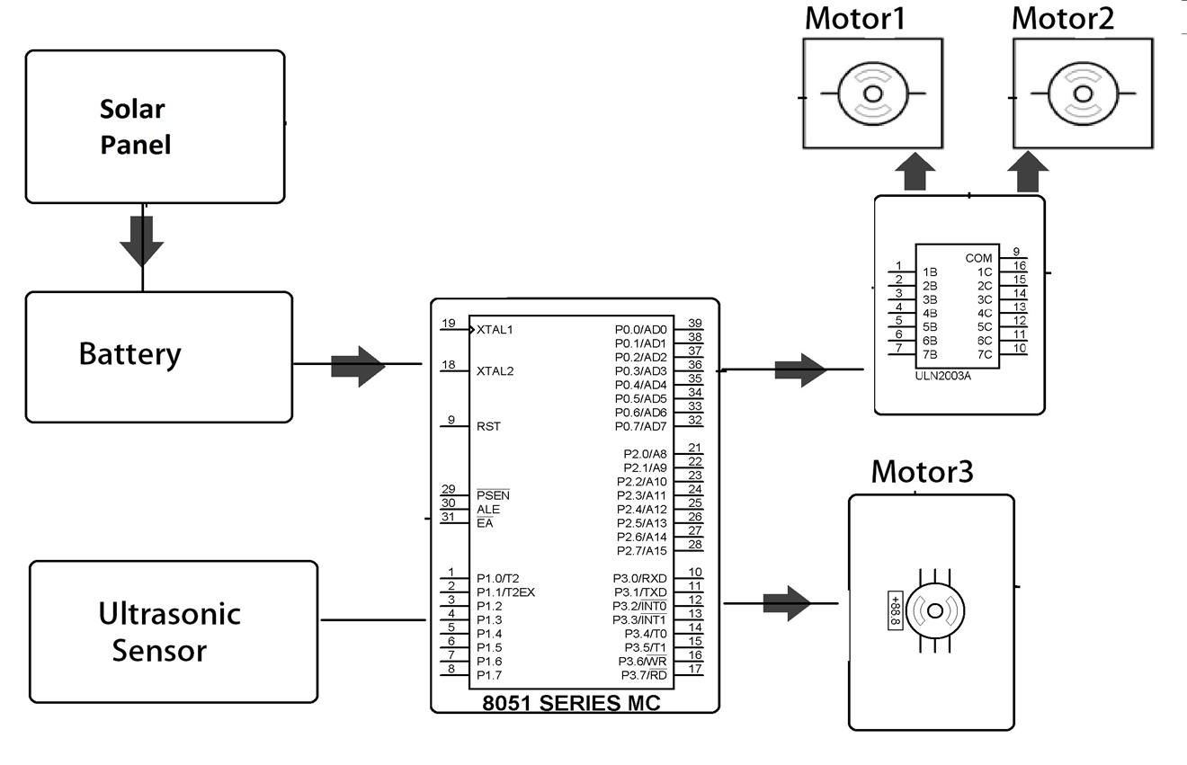
Methodology
Fig 1.2 Block Diagram of solar Grass cutter

Slide 9
Methodology
Hardware Components
Name of Component | Quantity
Solar Panel | 1
Arduino UNO kit | 1
L298N Motor Driver | 1
Brushless DC Motors | 3
Ultrasonic Sensor HC-SR04 | 1
Gyroscope Sensor and Accelerometer | 1
Rotary Cutter blade | 1
Wheel | 2
Standard Wire | 10m
Table 1.2

Slide 10
Methodology
Software
Arduino Compiler
MC Programming Language: C

Slide 11
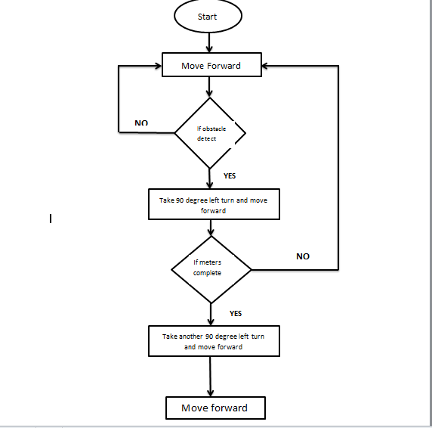
Fig 1.3 Flowchart of Smart Grass Cutter

Slide 12
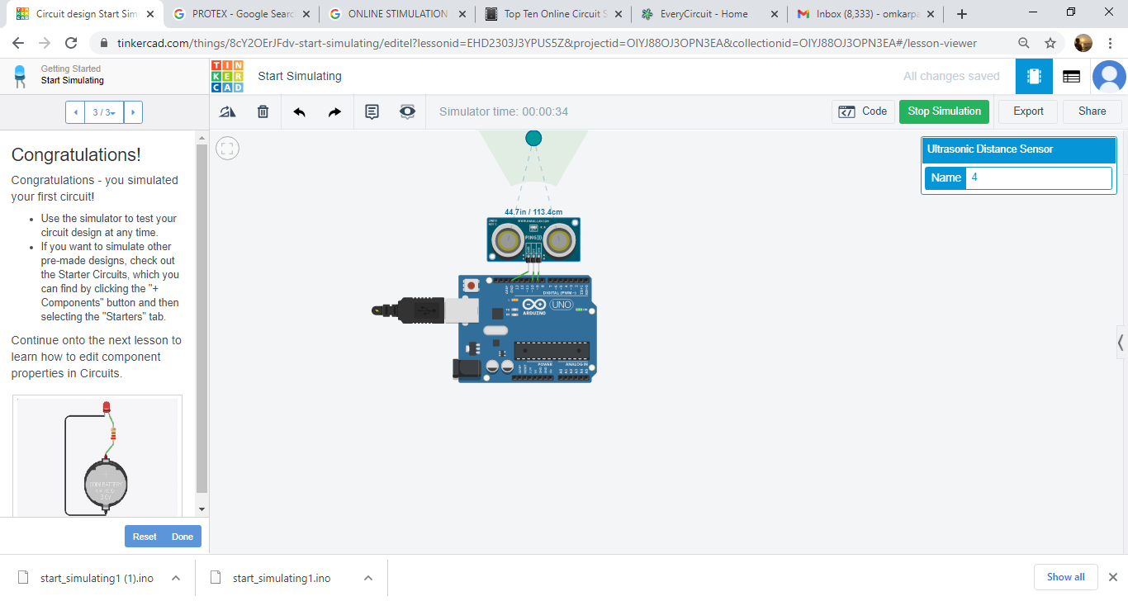
Design System
WORK EXECUTED
We have compiled and simulated the circuit online with tinkercad software tool and Arduino IDE tool
Fig 1.4 output of Ultrasonic sensor
Source [Tinkar CAD]

Slide 13
Design System
PLAN OF ACTION
If Pandemic Goes Over | If Pandemic continues
We will complete our programming/ software work | We will complete our programming/ software work
We will buy components from store | We will order components from online sites
Hardware installation will distributed among all group members | Hardware installation will be done by only one person
Documentation work will be distributed among all members | Documentation work will be done by all group members
Table 1.4

Slide 14
Advantages and Limitations
Limitation | Advantage
Difficult in rainy | Less maintances
--------- | Low cost
-------- | Renewable and Easy to use
Table 1.4

Slide 15
Applications
In cricket ground.
The football ground.
In all garden and playground

Slide 16
References
[Ref 1]
[Ref 2]
[Ref 3]
[Ref 4]
[Ref 5]
R.Sivgurunathan et al “Design and Fabrication of low cost portable Lawn Mowers” volume no:04 issue:02,Feb 2018,International research journal of engineering and technology.
Z.I.Rizman et al “An Improved controller for grass cutting” issue: 15 Jan 2018
A . P .Pralhad , “Solar Powered Automatic grass cutter and pesticide spreading robot”, issue :05 may 2011
Ms.Yogita D. Ambekar, Mr. Abhishek U. Ghate, “Solar based grass cutter”, ISBN:978-93-86171-31-3, 26 Feb 2017
S.Mohyuddin et al ,“Automated solar Grass cutter” issue :May 2016

Slide 17

Thank You

